Slide 1
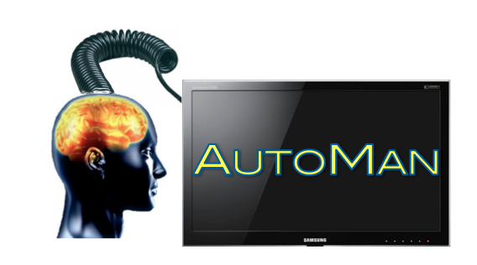
Programming with People: Integrating Human-Based & Digital Computation
Emery Berger, Dan Barowy, Charlie Curtsinger, Andrew McGregor University of Massachusetts, Amherst

Slide 2
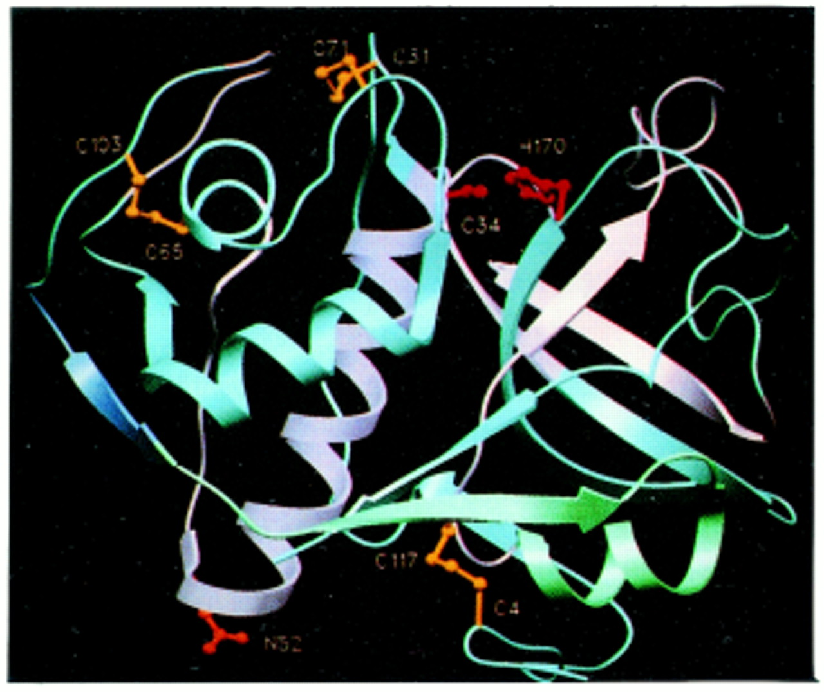
Notes:
Digital computation – success story. Lots of great stuff like decoding the human genome

Slide 3
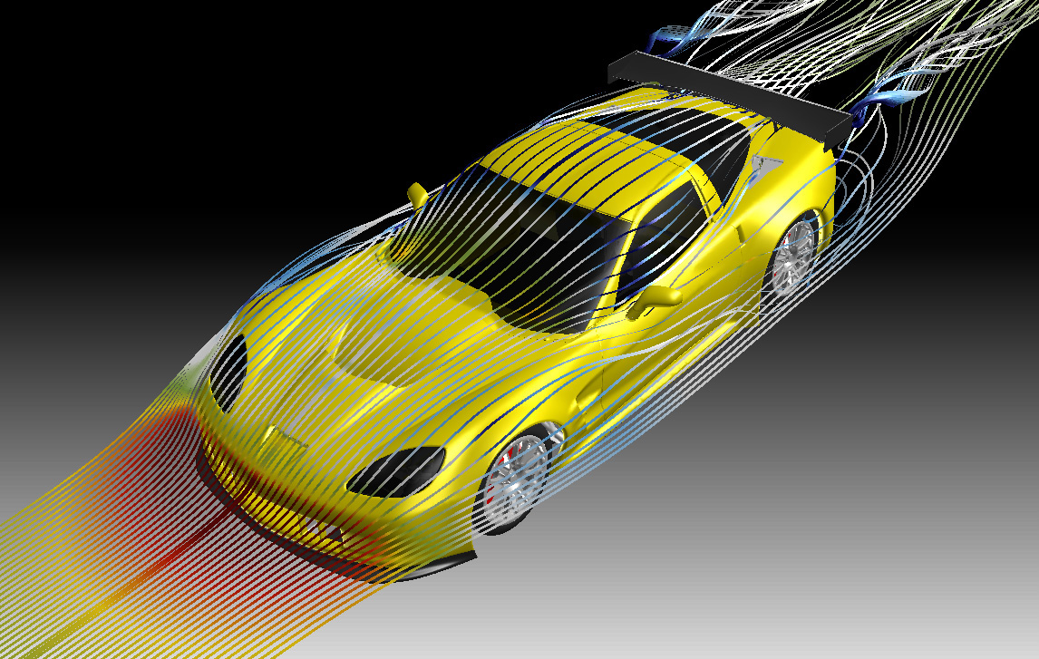
Notes:
Computers great at some things – aerodynamic simulation

Slide 4
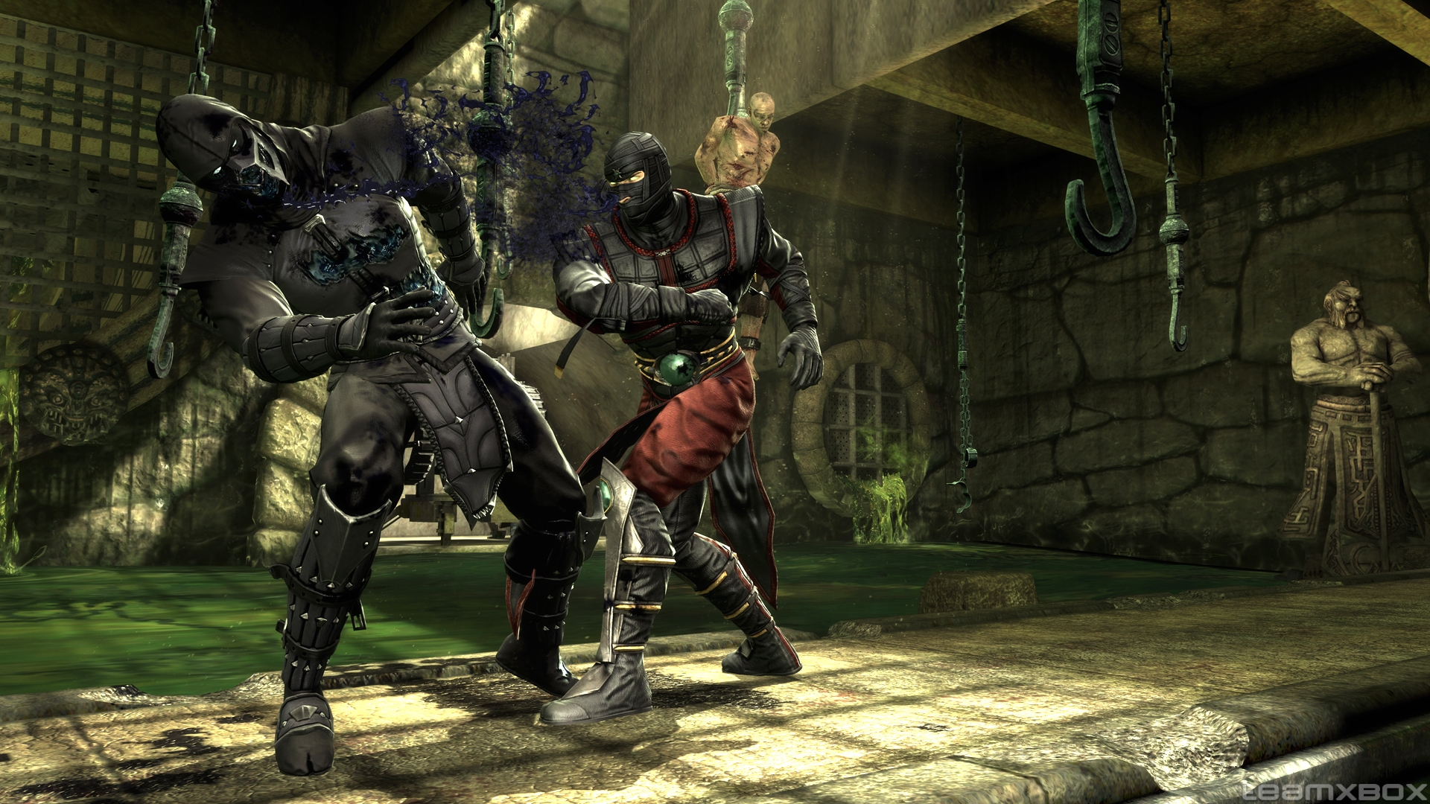
Notes:
3D simulations

Slide 5
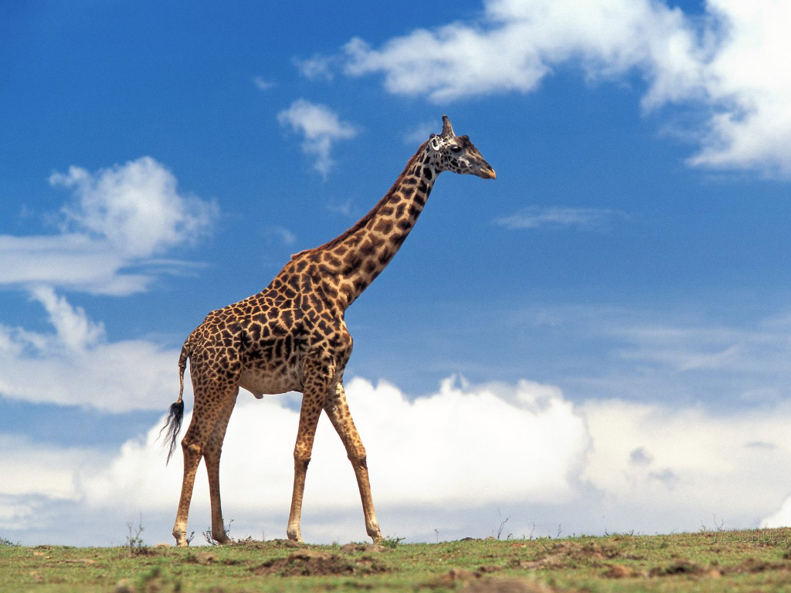
Notes:
Computers not so good at other tasks

Slide 6
“is this a giraffe?”
Notes:
Computers not so good at other tasks

Slide 7
isGiraffe(image)
Notes:
Can’t just call this function. What’s the answer?

Slide 8
isGiraffe( )

Slide 9
isGiraffe( )

Slide 10
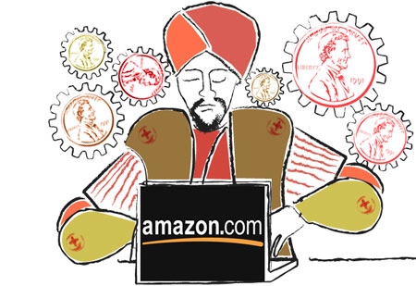
isGiraffe( )

Slide 11
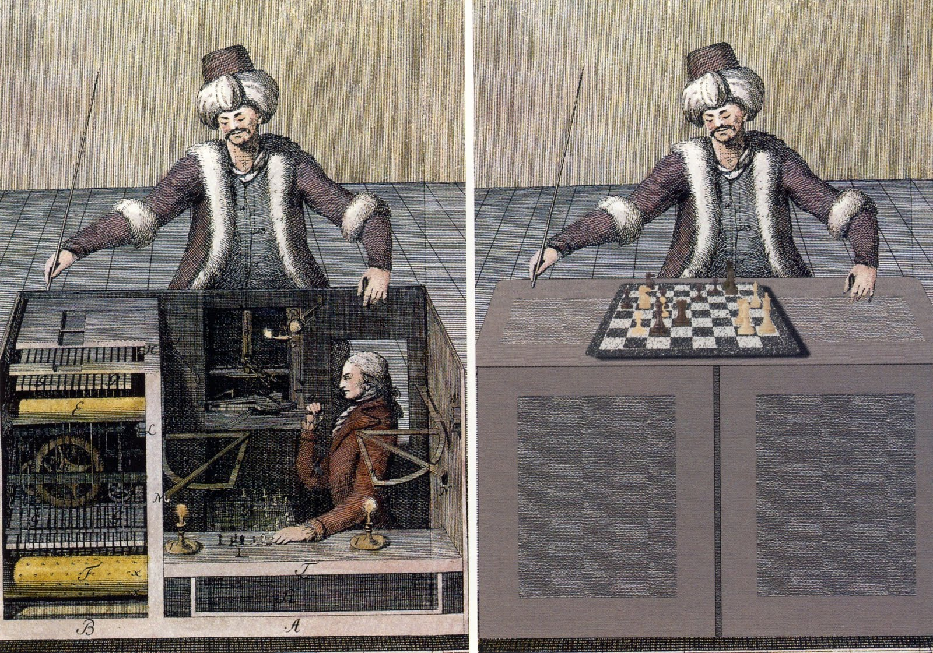

Slide 13
isGiraffe( )
True
Notes:
Great – but lots of challenges.

Slide 14

isGiraffe( )
True
Notes:
You have to pay workers. How much should you pay?

Slide 15
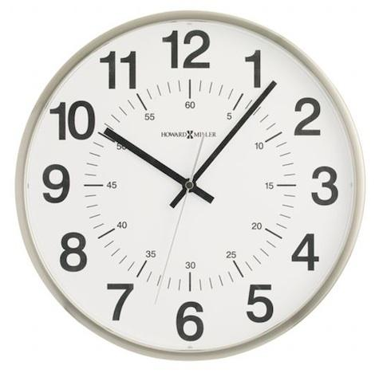
isGiraffe( )
True
Notes:
How long should the task take?

Slide 16
isGiraffe( )
False
Notes:
And most importantly, how do we know the answer is right? What if they answer incorrectly?

Slide 17

isGiraffe( )
False
Notes:
We need *confidence* in our results. People might just guess!

Slide 18
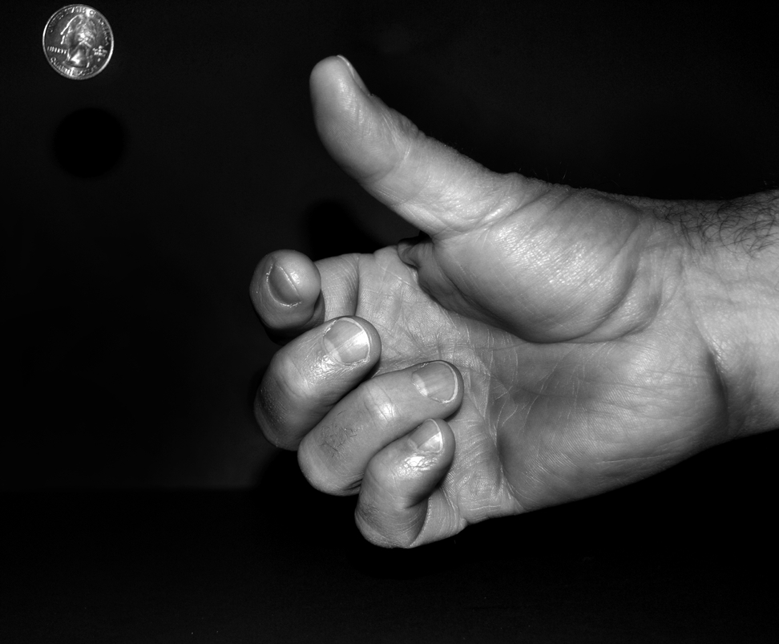
Notes:
Workers can be lazy and might just guess the answer

Slide 19
isGiraffe( )
?

Slide 20
isGiraffe( )

Slide 21
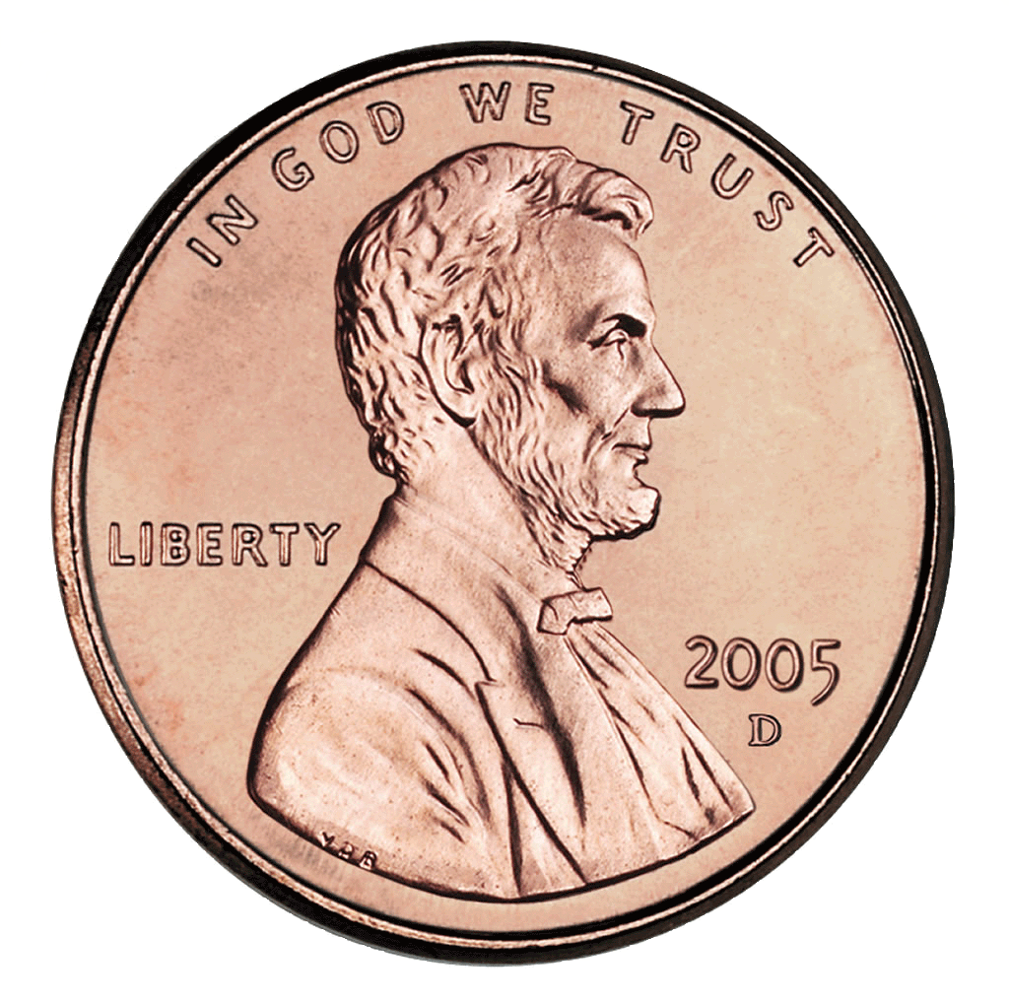

isGiraffe( )

Slide 22
isGiraffe( )
P(agreement) = ½

Slide 23
isGiraffe( )
P(agreement) = 1/32 (< 5%)

Slide 24
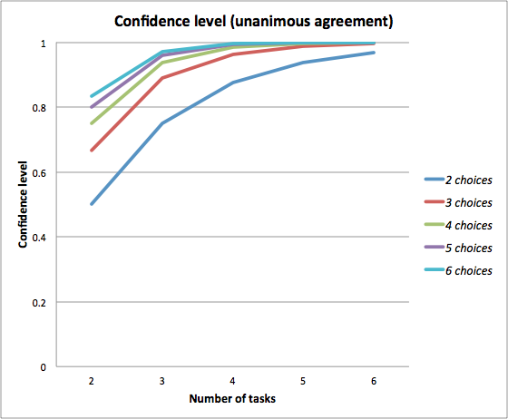

Slide 25
isGiraffe( )
Notes:
We need *confidence* in our results.
AutoMan automatically handles all of these problems.

Slide 26

isGiraffe( )
( )
Notes:
We need *confidence* in our results.
AutoMan automatically handles all of these problems.

Slide 27
isGiraffe( )
( )
AutoMan programmer-specified
Total $ for computation
Notes:
We need *confidence* in our results.
AutoMan automatically handles all of these problems.

Slide 28
isGiraffe( )
( )
AutoMan programmer-specified
Total $ for computation
95% (p < 0.05)
Confidence level (per function)
Notes:
We need *confidence* in our results.
AutoMan automatically handles all of these problems.

Slide 29
isGiraffe( )
US minimum wage,
Adaptive doubling
Notes:
We need *confidence* in our results.
AutoMan automatically handles all of these problems.

Slide 30
isGiraffe( )
US minimum wage,
Adaptive doubling
30s, $0.06 ($7.25 / 120)
Notes:
We need *confidence* in our results.
AutoMan automatically handles all of these problems.

Slide 31
isGiraffe( )
US minimum wage,
Adaptive doubling
30s, $0.06 ($7.25 / 120)
60s, $0.12
Notes:
We need *confidence* in our results.
AutoMan automatically handles all of these problems.

Slide 32
isGiraffe( )
True
95% confidence
Notes:
We need *confidence* in our results.
AutoMan automatically handles all of these problems.

Slide 34
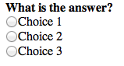
“radio button”

Slide 35
“radio button”
n choices (3)

Slide 36
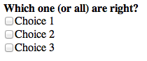
“radio button”
n choices (3)
“checkboxes”

Slide 37
“radio button”
n choices (3)
“checkboxes”
2^n choices (8)

Slide 38
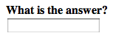
“radio button”
n choices (3)
“checkboxes”
2^n choices (8)
“text”

Slide 39
“radio button”
n choices (3)
“checkboxes”
2^n choices (8)
“text”
computed/provided

Slide 40
Notes:
He LOOKS so SAD! What makes him happy? What motivates him?

Slide 41

Notes:
Money. That’s why he’s there. He likes money.

Slide 42
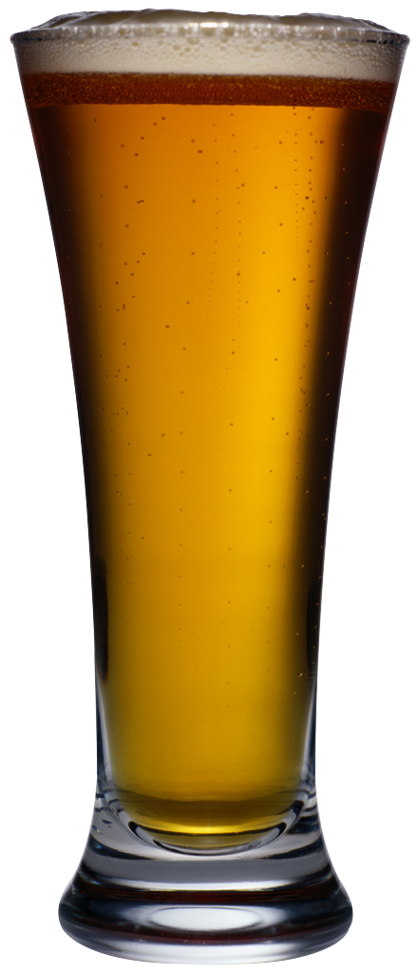
Notes:
But! He is also lazy. He wants to finish his job as fast as possible. What are the implications?

Slide 44
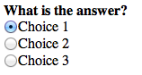

Slide 45
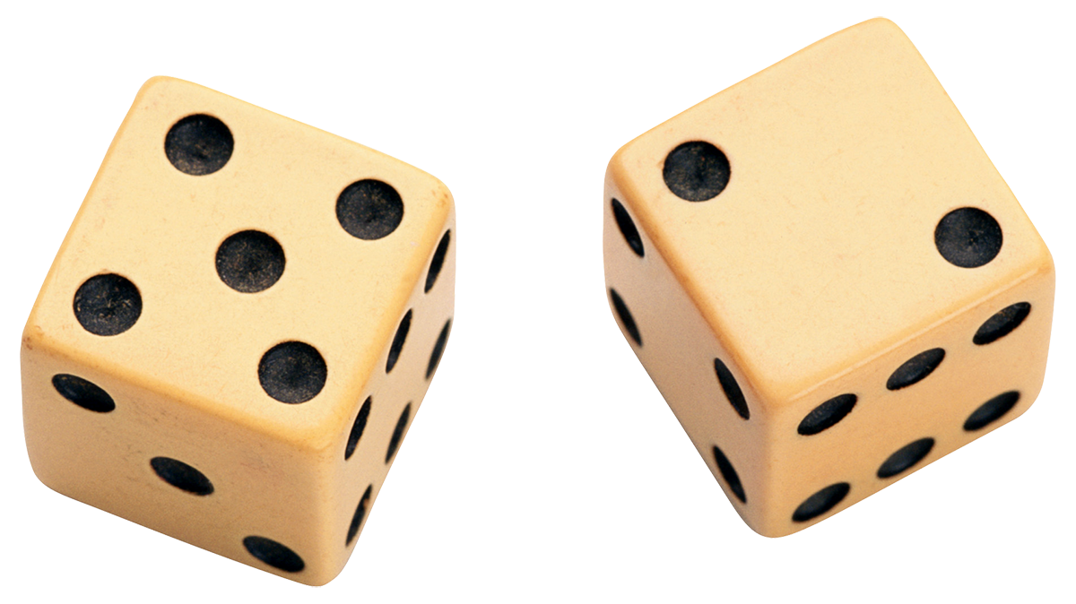

Slide 46
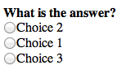
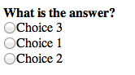

Slide 48
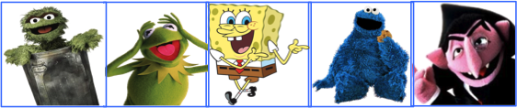
Which one of these doesn’t belong? [95% conf.]
Notes:
Here’s a toy example execution. Very hard to do by computer. Let’s just ask people.

Slide 49
Which one of these doesn’t belong? [95% conf.]
AutoMan: spawns 3 tasks @ $0.06; 30s work
t₁
t₂
t₃

Slide 50

Which one of these doesn’t belong? [95% conf.]
AutoMan: spawns 3 tasks @ $0.06; 30s work
t₁
t₂
t₃
1m 50s

Slide 51
Which one of these doesn’t belong? [95% conf.]
AutoMan: spawns 3 tasks @ $0.06; 30s work
t₁
t₂
t₃
1m 50s
2m 30s

Slide 52

Which one of these doesn’t belong? [95% conf.]
AutoMan: spawns 3 tasks @ $0.06; 30s work
t₁
t₂
t₃
1m 50s
2m 30s
2m 50s

Slide 53
Which one of these doesn’t belong? [95% conf.]
AutoMan: spawns 3 tasks @ $0.06; 30s work
t₁
t₂
t₃
1m 50s
2m 30s
Inconclusive!
2m 50s

Slide 54
Which one of these doesn’t belong? [95% conf.]
AutoMan: spawns 3 more tasks
t₁
t₂
t₃
t₄
t₅
t₆

Slide 55
Which one of these doesn’t belong? [95% conf.]
AutoMan: spawns 3 more tasks
t₁
t₂
t₃
t₄
t₅
t₆
7m

Slide 56
Which one of these doesn’t belong? [95% conf.]
AutoMan: spawns 3 more tasks
t₁
t₂
t₃
t₄
t₅
t₆
7m
18m 50s

Slide 57
Which one of these doesn’t belong? [95% conf.]
AutoMan: spawns 3 more tasks
t₁
t₂
t₃
t₄
t₅
t₆
7m
18m 50s
51m

Slide 58
Which one of these doesn’t belong? [95% conf.]
AutoMan: spawn 1 more task @ $0.12, 60s work
t₁
t₂
t₃
t₄
t₅
t₆
t₇

Slide 59
Which one of these doesn’t belong? [95% conf.]
AutoMan: spawn 1 more task @ $0.12, 60s work
t₁
t₂
t₃
t₄
t₅
t₆
t₇
1h 9m 50s;
cost = $0.36
AutoMan: 5 out of 6 ⇒ 95% confidence;
return

Slide 60
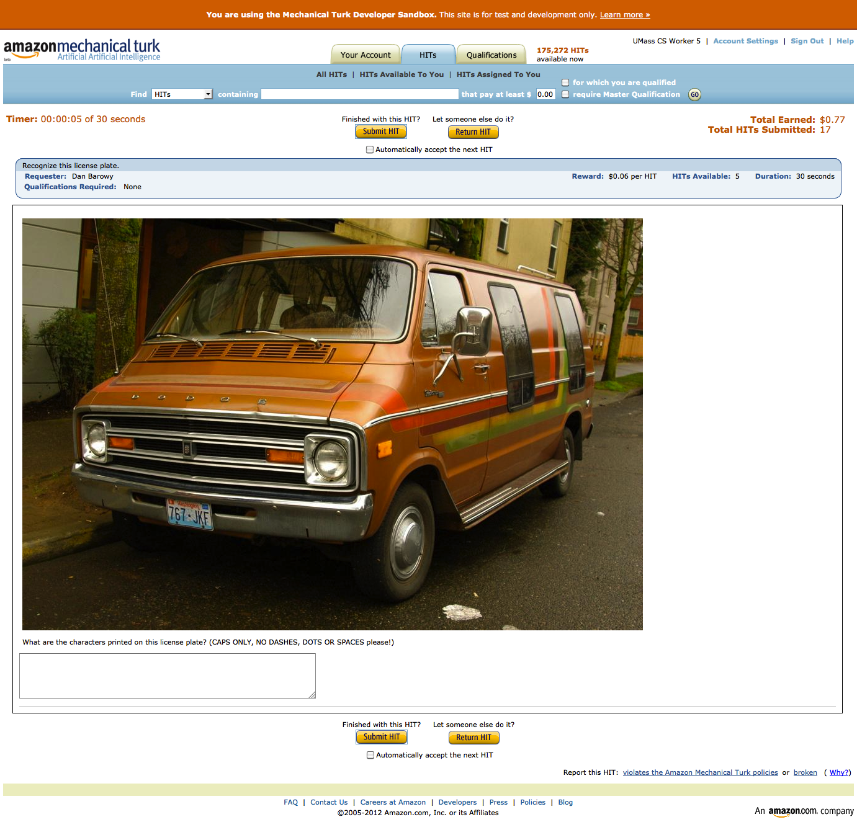

Slide 61
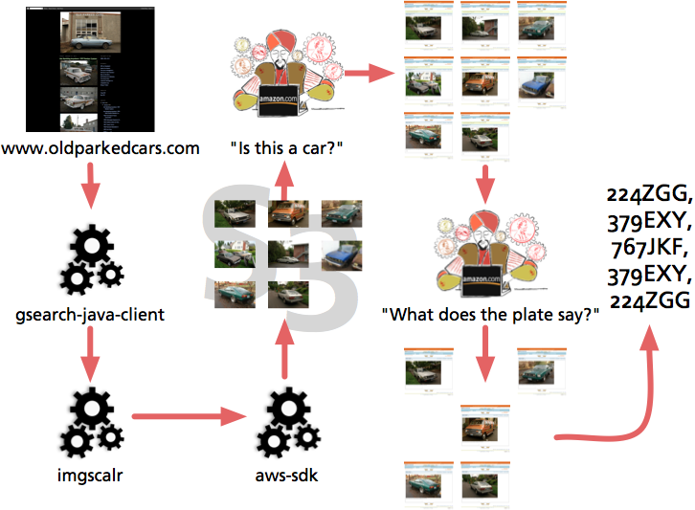

Slide 62
def is_readable_plate(image_url: String) = {
a.Task[String] { t =>
t.question = a.MultipleChoiceQuestion (
question_text = "Does this image PRIMARILY SHOW a vehicle with a CLEARLY READABLE license number plate?",
selection_texts = Map('yes -> "Yes.", 'no -> "No."))
t.question.image_url = image_url
}
}

Slide 63
def get_plate_text(image_url: String) = {
a.Task[String] { t =>
t.confidence = 0.90
t.title = "Recognize this license plate.”
t.question =
a.FreeTextQuestion("What are the characters printed on this license plate? (CAPS ONLY, NO DASHES, DOTS OR SPACES please!)")
t.question.num_choices = BigInt(36).pow(6)
// [A-Z0-9]
t.question.image_url = image_url
}
}

Slide 64
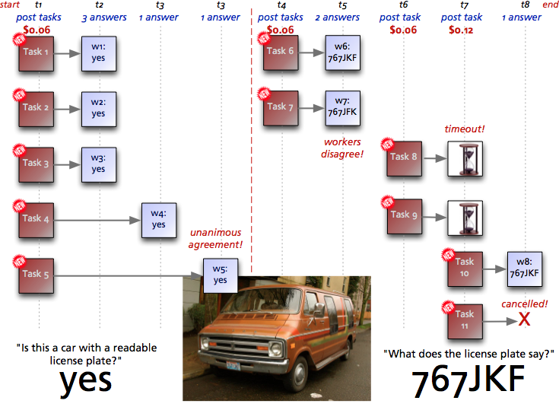

Slide 65
Coming Attractions
General question answering (e.g. translation tasks)
Java / Web service API
Optimizations (time and $)

Slide 66
www.automan-lang.org

Slide 67
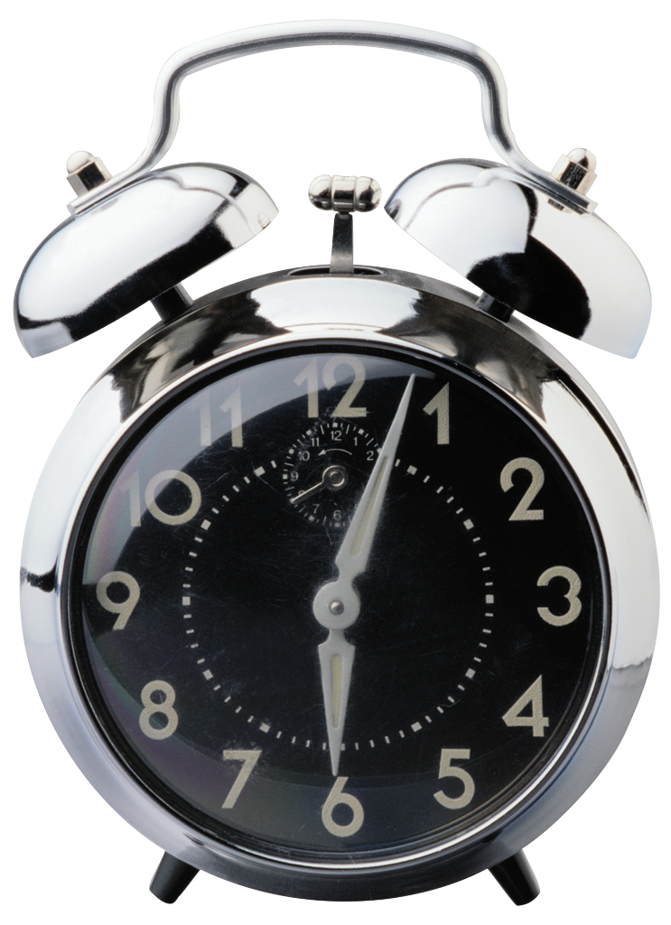
Notes:
Weird optimization opportunities. We think of optimizations as reducing time. How can we do that here?

Slide 68
=

Slide 69
=
Worker time = $7.25/hr

Slide 70

=
Worker time = $7.25/hr
Your time = $200/hr

Slide 71
=
Worker time = $7.25/hr
Your time = $200/hr
➔

Slide 72
=
Worker time = $7.25/hr
Your time = $200/hr
➔
Speculative Execution

Slide 73
www.automan-lang.org

Slide 74


Slide 75
Coming Attractions
General question answering (e.g. translation tasks)
Java / Web service API
Optimizations (time and $)

Slide 76
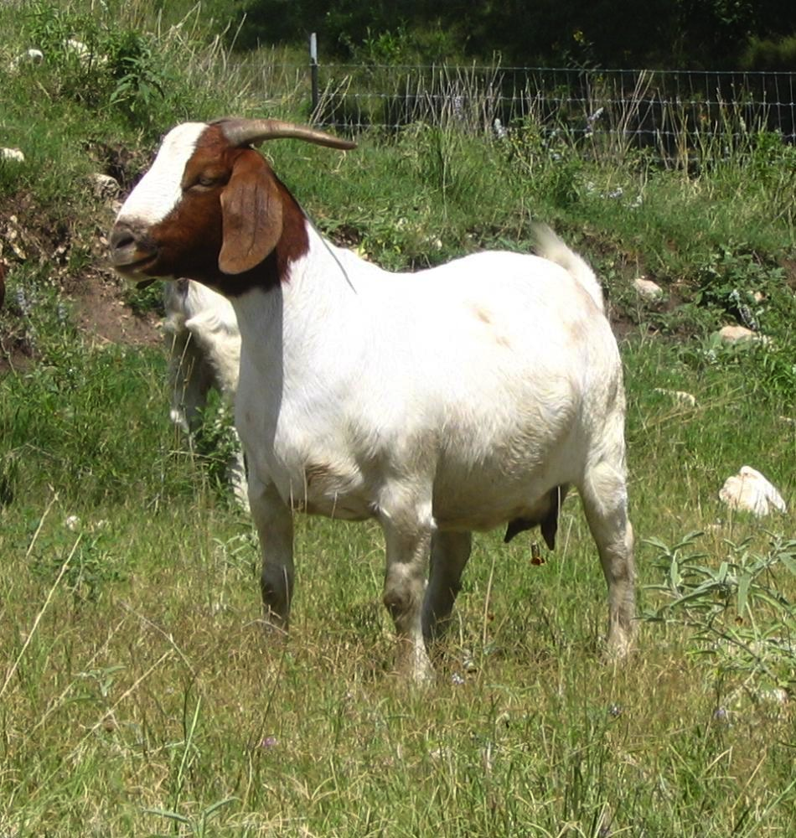
How many goats?

Slide 77


